Slide 1
INDEPENDENT ANALYSIS
CUSTOMER PERSONALITY ANALYSIS
JAYAPRAKASH KUMAR

Slide 2
INTRODUCTION
GOAL :
To optimize marketing strategies to increase sales by identifying and targeting specific customer segments characterized by fields like their marital status, education levels, income and versatile spending behavior across all product categories.
OBJECTIVE:
To engage and retain high-value customers with a focus on personalized approaches, cross-selling, and online sales expansion.

Slide 3
DATASET OVERVIEW
Customer Personality Analysis is a thorough examination of a company's desired client profiles. It is a helpful tool for organizations to obtain deeper insights into their client base and change their goods to better cater to the unique needs, behaviors, and interests of diverse customer segments.
A company can adjust its products to the tastes of specific client segments by undertaking customer personality analysis. For example, rather of investing resources in promoting a new product to all customers in the company's database, the company can discover the customer segment most likely to acquire the product and focus its marketing efforts just on that segment.

Slide 4
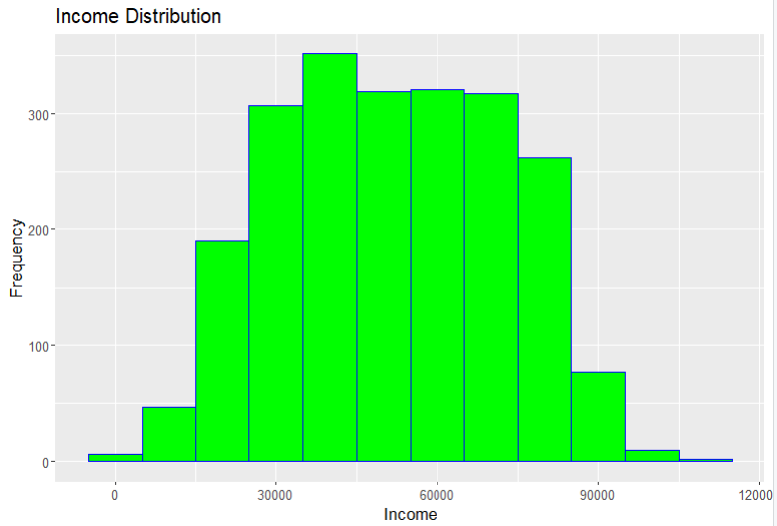
Histogram - Distribution of the Income data
The dataset is normally distributed.
Columns : Income and its frequency
According to Kurtosis, it’s a Platykurtic distribution.

Slide 5
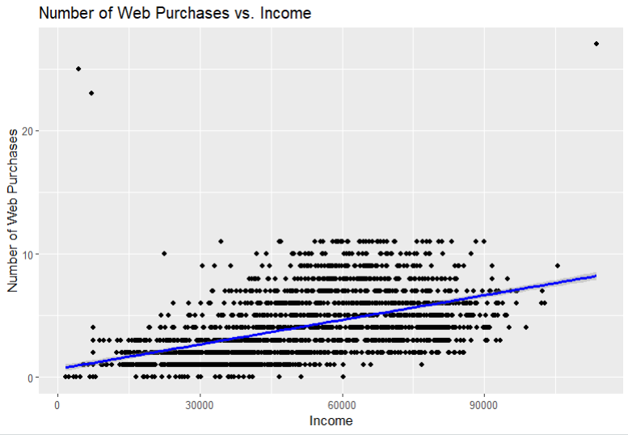
Analysis of 'Number of Web Purchases'
Is customers’ income level a crucial factor for web purchases worth?
It indicates correlations with key customer attributes “Income” and “Web Purchases”
Inference : Positive correlation found.
Customers with higher incomes tend to make more web purchases.

Slide 6
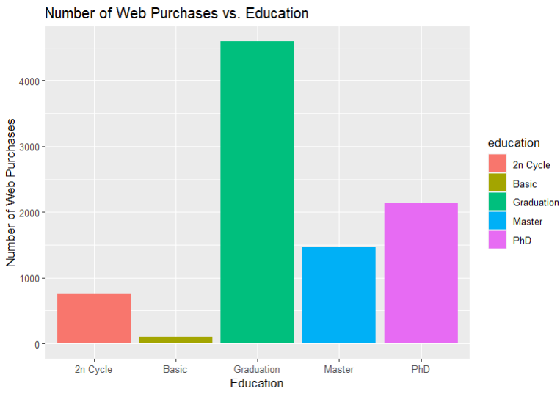
Correlation between Education and Web purchases
Does educational qualification affect the web purchases worth? If so, which group is consistent in web purchases?
These insights will guide targeted marketing strategies, enhancing engagement and sales.
Inference : Graduation completed people make more web purchases.

Slide 7
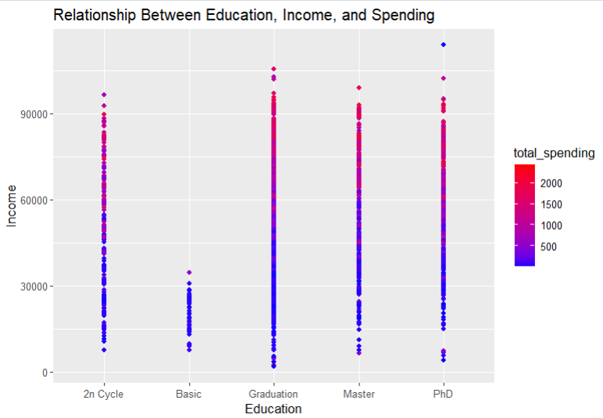
Customer Spending Analysis for Targeted Marketing Strategies
Is there a relation between the income level and the education of the customers?
This scatter plot reveals patterns in customer preferences and distribution of spending.
Inference : Customers spending is directly proportional to education and income.
Increase in spending is observed with people with higher education than basic and more income.

Slide 8
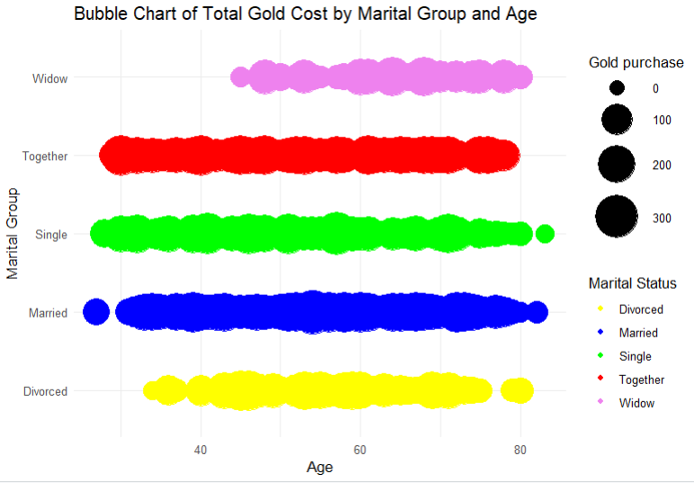
Relationship Between Marital status and Gold purchase
Gold is an investment (for customers) and a great sale (for the companies). Which group of customers are purchasing gold consistently (based on age, marital status)?
A Bubble chart is created to explore the relationship between marital status and Gold purchase.
Inference : Steady purchase of gold seen in Together, Single, Married from ages 25 years - 80 years

Slide 9
CONCLUSION
To make analysis and derive marketing strategies to increase sales by identifying and targeting specific customer segments characterized by their marital status, education levels, income and versatile spending behavior has been a challenging task.
Plotting suitable charts to answer the data questions has been challenging.
Target Group : Customers who completed Graduation, ones with high income and within the age groups ‘single’ and ‘married’ are making more purchases which can be a chance to increase more sales and revenue generation
Strategy :
Promote premium and high-value products on your e-commerce platform to attract customers with higher incomes.
Develop marketing campaigns that highlight the convenience, quality, and exclusive deals available on the online platform to appeal to educated customers.
Leverage digital platforms for targeted advertising, ensuring the products like Gold reach this demographic effectively.

Slide 10
BIBLIOGRAPHY
Dataset - Customer Personality Analysis - https://www.kaggle.com/datasets/imakash3011/customer-personality-analysis
R documentation - Sys.date() and format - https://stat.ethz.ch/R-manual/R-devel/library/base/html/Sys.time.html
Integer Typecasting - https://www.educative.io/answers/what-is-the-asinteger-function-in-r
Recode function - https://dplyr.tidyverse.org/reference/recode.html
Bubble chart - https://r-charts.com/correlation/bubble-chart-ggplot2/

